Slide 1
MCQ Test App
Presented By:-
Aayush Rauniyar(PUR079BCT003)
Lokendra Joshi(PUR079BCT036)
Basanta Raj Khatiwada(PUR079BCT017)
Mihir Gupta(PUR079BCT040)

Slide 2
Introduction
Hello everyone! Today, We are thrilled to present our college project—a dynamic MCQ Test App tailored for interactive assessments! 🎓
🎯 Purpose: To create an efficient app for conducting multiple-choice question tests, making assessments engaging and informative.
💡 Key Features:
Streamlined student enrollment and login process.
User-friendly interface for instructors to create and manage tests.
Real-time test results for immediate feedback.
Empowering students to track their progress and learning.
🌟 Our Mission: Enhance the learning experience and foster a deeper understanding of subjects through effective assessments. Let's explore the wonders of MCQ Test App! 🚀

Slide 3
Project overview
Welcome to our MCQ Test App—an interactive and efficient platform revolutionizing the way assessments are conducted in our college!
🎯 Purpose: Our project aims to provide a user-friendly MCQ Test App that enables students and instructors to conduct engaging and informative multiple-choice question-based assessments. By embracing technology, we seek to enhance the learning experience and make assessments more effective.
💡 Key Features:
Student Enrollment: Students can easily enroll themselves by providing their personal information and unique identification number.
Practice Tests: Students can take practice tests with the flexibility to choose the number of questions they want to attempt.
Full Mock Tests: Full-length mock tests are available, giving students an authentic exam experience.
Immediate Feedback: The app provides instant feedback on test results, helping students learn from their mistakes.
Leaderboard: We have implemented a leaderboard system to showcase the top-performing students.
🌟 Our Vision: With our MCQ Test App, we aim to transform the assessment process by making it more efficient, insightful, and enjoyable for both students and instructors. This project showcases the fusion of our programming skills and educational insights, creating an innovative solution for educational assessment.

Slide 4
Objectives
Our MCQ Test App project is designed to achieve the following objectives:
Efficient Assessment Platform
Student Enrollment and Management
Flexible Practice Tests
Instant Feedback and Score Tracking
Comprehensive Full Mock Tests
Leaderboard System
Admin Features
User Data Security

Slide 5
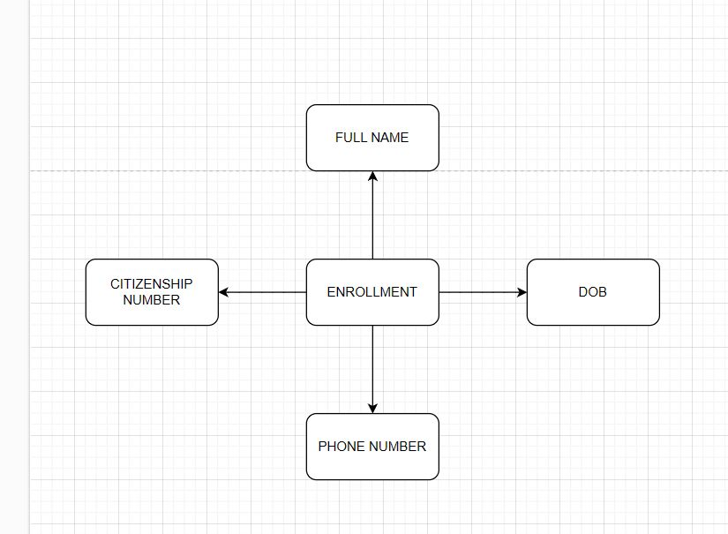
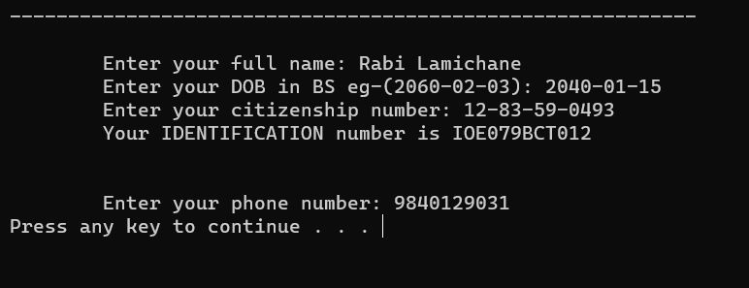
Features
Our MCQ Test App is packed with a range of features designed to enhance the assessment experience for students and streamline the process for instructors:
Student Enrollment:

Slide 6
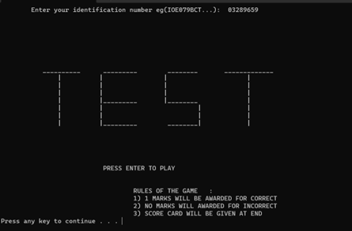
2. Practice Tests

Slide 7
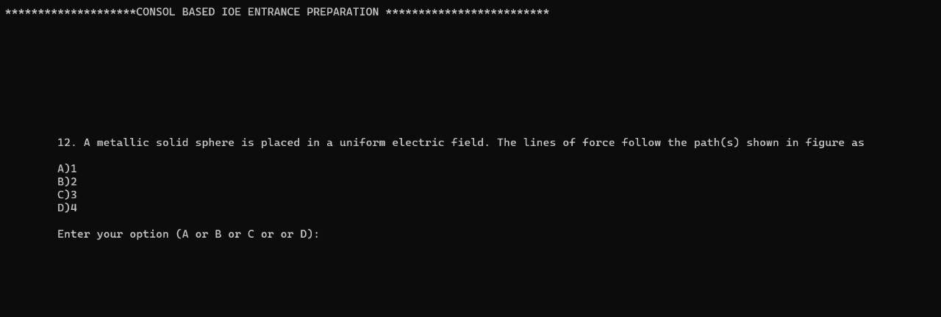

3. Full Mock Tests

Slide 8

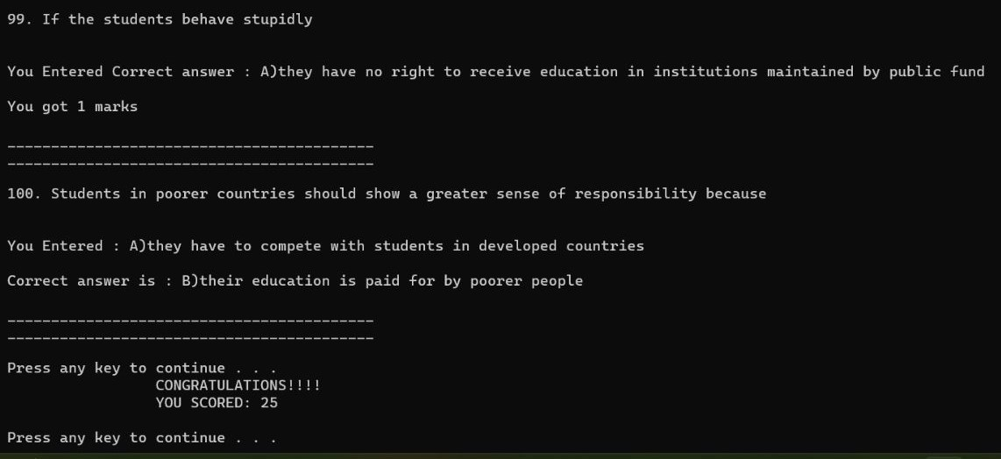


4. Immediate Feedback
25 MARKS

Slide 9
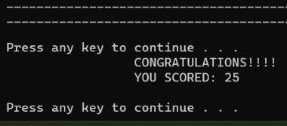
5. Score Tracking

Slide 10

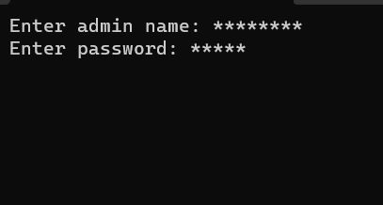
6. Admin Functionalities

Slide 11

7. Leaderboard
Implements a leaderboard system to showcase top-performing students based on their scores.
Fosters healthy competition and motivation among students

Slide 12

8. Data Security
Ensures the security and privacy of student data through secure file handling techniques.
Adheres to data protection standards to maintain confidentiality.

Slide 13

9. Efficient File Handling
Utilizes C's file handling capabilities for efficient data storage and retrieval.
Enables easy management of student records and test questions.

Slide 14
10. Console-Based Interface
Offers a simple and intuitive console-based interface for easy interaction.
Ensures user-friendliness and accessibility for all users.
Our MCQ Test App combines cutting-edge technology, efficient data handling, and an engaging user interface to provide a comprehensive and effective assessment platform for students and instructors alike.

Slide 15

DEMONSTRATION

Slide 16

Any queries?
THANK YOU!

Slide 17
REFERENCE
https://www.geeksforgeeks.org/
https://www.programiz.com/
https://www.tutorialspoint.com/
ChatGPT

